Slide 1
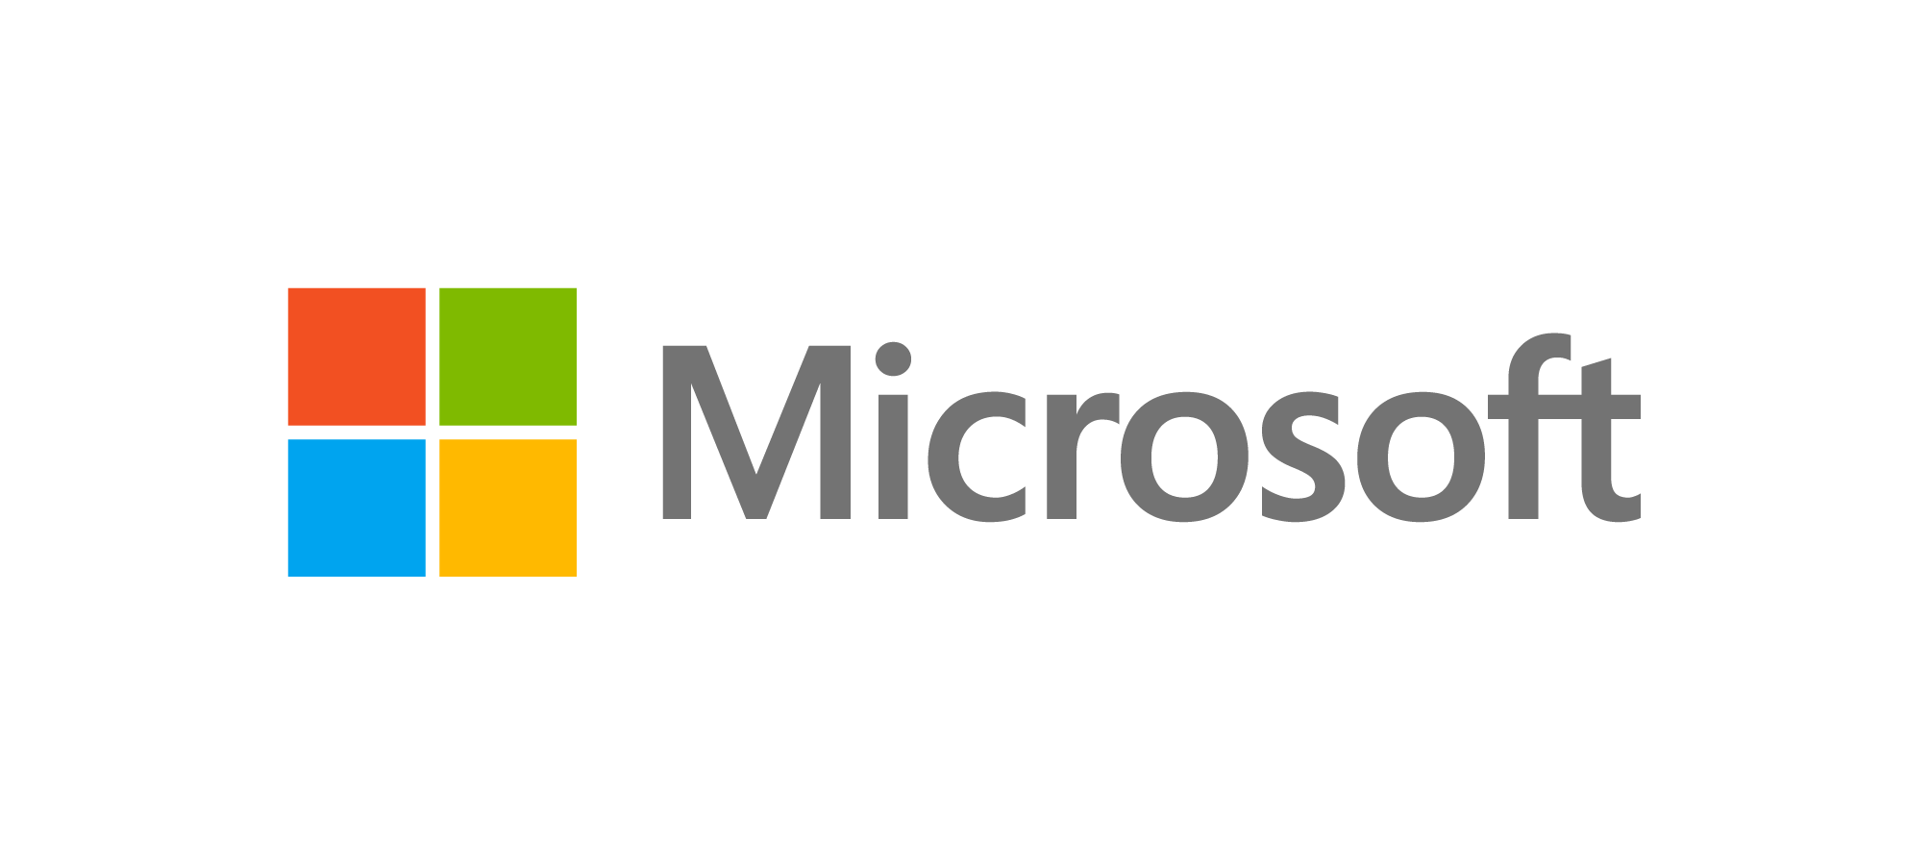
Low-code drives business transformation
Low-code development platforms are on the rise, allowing businesses to more easily develop custom applications to solve their unique challenges. Microsoft Power Apps uses this approach to help businesses reduce development costs and increase overall efficiency.
Microsoft is recognized by analysts as a leader in low-code application development platforms, demonstrating a strong strategy and vision, and ability to execute. Learn why and discover the benefits of Power Apps, outlined in a recent commissioned study by Forrester Consulting.
188%
74%
4.3%
ROI over three years
reduction in app development costs
revenue uplift linked to increased, faster development efforts
3.2
22%
132,000
hours/week average improvement in line-of-business employee productivity
of global developers reported using low-code platforms and another 23% planned to do so within the year
worker hours saved from streamlined and automated activities (Year 3)

